Slide 1



VLSI IMPLEMENTATION IN HARDWARE SECURITY MODULE BASED ON AES ENCRYPTION METHOD
Primary goal no | : | 9
Secondary goal no | : | 11
Tertiary goal no | : | 16

Slide 2

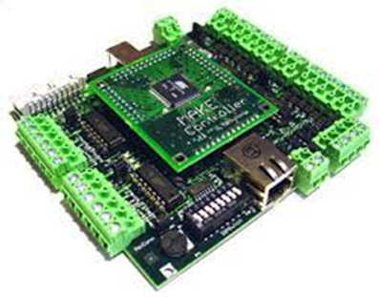

To enhance system security, we would employ our adaption of AES encryption to fortify the hardware security module's security in a Network Centric Warfare Ecosystem.
A HSM(Hardware Security Module) chip is embedded in a Microcontroller of a System.

Slide 3


Cryptography is very important now-a-days for data security and integrity as the ecommerce and internet applications has increased. But, it has least importance in many cases because of extra memory and other requirements needed for the implementation. The main aim of this work is to implement Advanced Encryption Standard (AES) Encryption using Verilog. To protect data like electronics, cryptographic algorithms are used. Each round of encryption associated with delay can be reduced by AES parallel design. This work proposes a low power and high throughput implementation of AES algorithm using key expansion approach. We minimize the power consumption and critical path delay using the proposed high-performance architecture. The fundamental goal of the initiative is to increase data flow, although security considerations have become increasingly important over time. The use of encryption and decryption techniques inside VLSI has recently increased since cryptography can convert plaintext to cipher and vice versa. The most recent developments in cryptography technology will be applied in the hardware security module. by simultaneously writing a lot of HDL modules. The main objective is to send and receive data securely without allowing data to be hacked, as well as to improve the performance of a specific parameter. The methodology involved in this system is Verilog code. To support both analog and digital circuit designing, Xilinx provides analog and digital platform. It is interesting to note that any encryption algorithm works in a digital environment and all the blocks in the system will handle digital data in security.

Slide 4
S.no | Journal details And Year | Authors and title of the paper | Inference
1 | Journal of Electrical Systems and Information Technology 2 (2015) 178–183 | Power efficient and high performance VLSI architecture for AES algorithm K. Kalaiselvi a,∗, H. Mangalam | Advanced encryption standard(AES) algorithm has been widely deployed in cryptographic applications. This work proposes a low power and high throughput implementation of AES algorithm using key expansion approach.

Slide 5
S.no | Journal details And Year | Authors and title of the paper | Inference
2 | IEEE 2013 | VLSI IMPLEMENTATION OF AES ALGORITHM SAURABH KUMAR | This paper presents In the past cryptography means only encryption and decryption using secret keys, nowadays it is defined in different mechanisms like asymmetric-key encipherment (public key cryptography) and symmetric-key encipherment (called as privet-key cryptography).

Slide 6
S.no | Journal details And Year | Authors and title of the paper | Inference
3 | IEEE 2017 | VLSI Implementation of Cryptographic Algorithms & Techniques: A Literature Review Favin Fernandes, Gauravi Dungarwal, Aishwariya Gaikwad, Ishan Kareliya, Swati Shilaskar | Through the years, the flow of Data and its transmission have increased tremendously and so has the security issues to it. Cryptography in recent years with the advancement of VLSI has led to its implementation of Encryption and Decryption techniques, where the process of translating and converting plaintext into cypher text and vice versa is made possible

Slide 7
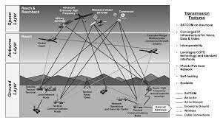
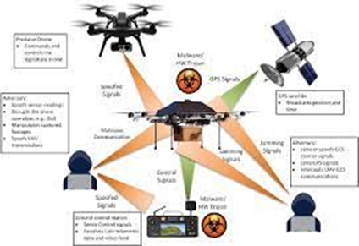
Security is becoming a crucial component of contemporary warfare.
Cyberattacks account for the majority of attacks. Cyberattack against Systems, Aircraft, Drones, and other Military Equipment, etc.
These seriously harm a nation's collateral. In order to achieve our goal of improving system security, we would use our adaptation of AES encryption to strengthen the security of the hardware security module, which is an HSM (Hardware Security Module) chip implanted in the system controller.

Slide 8
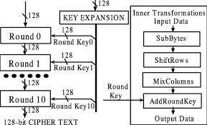

We would examine the most recent version of AES encryption first, modify it to reach the algorithm's optimum efficiency, and then implement it in a Hardware Security Module.
After that We would implement into a Controller for further study of the Security of the Controller System.

Slide 9
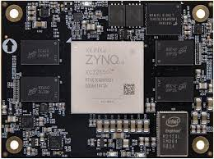

ZNQC FPGA Board
Viv ado Ise

Slide 10
Select an AES 256 algorithm
Analysis It and improve the efficiency of the algorithm
Write the program for this algorithm in Verilog (Xilinx after that Viv ado software)
Test the code in the normal FPGA Kit
Implement this chip on a controller
From this we can modify for the defence sectors
Test the code in the Zynq FPGA Kit
Check for the desired output

Slide 11
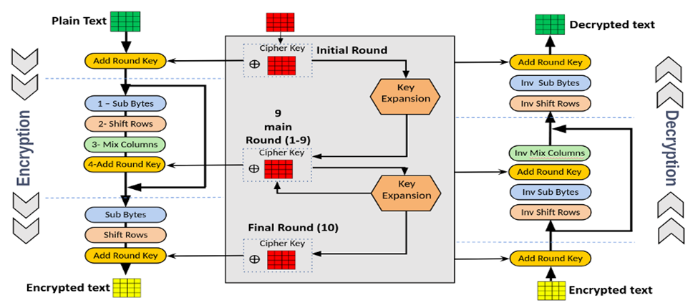

Slide 12
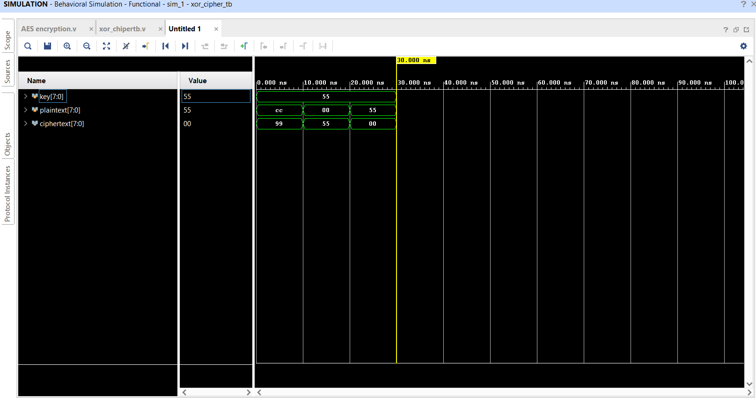

Slide 13
Problem in AES Encryption
One of the main issues that could potentially weaken the AES 256 encryption is related to implementation flaws rather than the algorithm itself. For example, if the implementation of AES 256 in a particular system is not done correctly, it could lead to vulnerabilities that could be exploited by attackers.
Another potential issue is related to side-channel attacks, where an attacker tries to extract information from the encryption process by analyzing various characteristics of the system, such as power consumption or electromagnetic radiation.
Additionally, a brute-force attack, where an attacker tries to guess the encryption key by trying all possible combinations, is theoretically possible. However, due to the large key size of AES 256 (256 bits), the number of possible combinations is so vast that it is practically impossible to execute such an attack with current computing resources.
Overall, while AES 256 is generally considered a strong encryption algorithm, it is important to use it correctly and implement it securely to prevent potential vulnerabilities and attacks.

Slide 14
Solution to Fixed the Problem
Implement the algorithm correctly: It is crucial to ensure that the implementation of AES 256 encryption in a system is done correctly to prevent vulnerabilities. Developers should follow best practices and guidelines when implementing the algorithm to ensure its security.
Use secure key management: The security of AES 256 encryption depends on the strength of the encryption key used. It is essential to use a secure key management system to generate, store, and distribute encryption keys securely.
Use secure cryptographic libraries: Developers should use well-tested and well-regarded cryptographic libraries to implement AES 256 encryption in their systems. These libraries often have built-in security measures to prevent implementation flaws.
Use secure hardware: Hardware-based encryption can provide additional security for AES 256 encryption. For example, using a hardware security module (HSM) can provide secure key storage and management, as well as protection against side-channel attacks.
Keep software and systems up-to-date: It is essential to keep software and systems up-to-date with the latest security patches and updates. This helps to address any known vulnerabilities and keep the system secure.

Slide 15
AES encryption is the finest encryption among RSA, DES, and AES, as we have learned by studying encryption techniques. This uses the most recent version of AES (256).
This leads us to the conclusion that this project might have research on the definition of cryptography, the AES encryption algorithm, and Xilinx software. From this study, we would modify the AES Encryption algorithm in the best way possible and implement it in the FPGA kit.

Slide 16
We intended to improve this project by implementing the best algorithm in the circuit using an FPGA kit.
This will increase the security of our military data.
We intended to improve this project by implementing the best algorithm in the h circuit using an FPGA kit.
Incorporate this into a controller so that we can test its security and create a Defense or Military product.
This will be given to the DRDO for use in their weapon.

